Slide 1

Welcome to Week 3! Link to Attendance Form ↓

Slide 2
What type of initialization can all types use?
Structured binding
auto [first, second] = p;
Member-wise
student.name = “Jacob”
Uniform initialization
Student jacob { “Jacob”, ”NM”, 21 }

Slide 3
What type of initialization can all types use?
Structured binding
auto [first, second] = p;
Member-wise
student.name = “Jacob”
✅ Uniform initialization
Student jacob { “Jacob”, ”NM”, 21 }

Slide 4
A stringstream is an…
Input stream
Output stream
Both!
Neither!

Slide 5
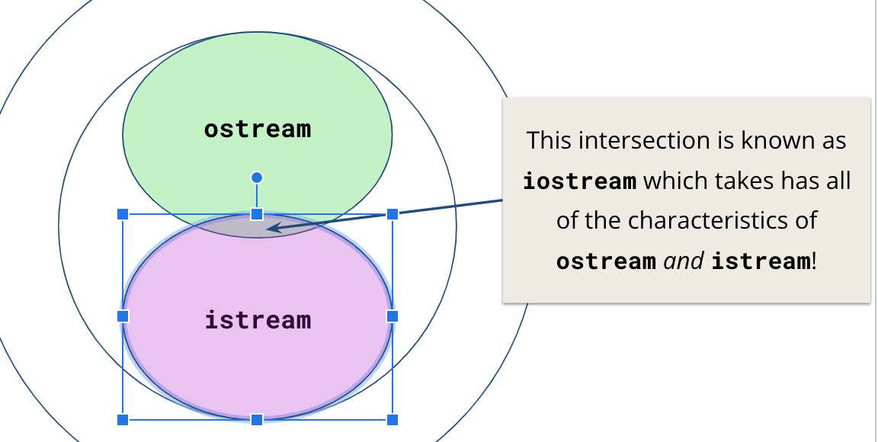
A stringstream is an…
Input stream
Output stream
✅ Both!
Neither!

Slide 6


Slide 7


A Disorganized Garage

Slide 8
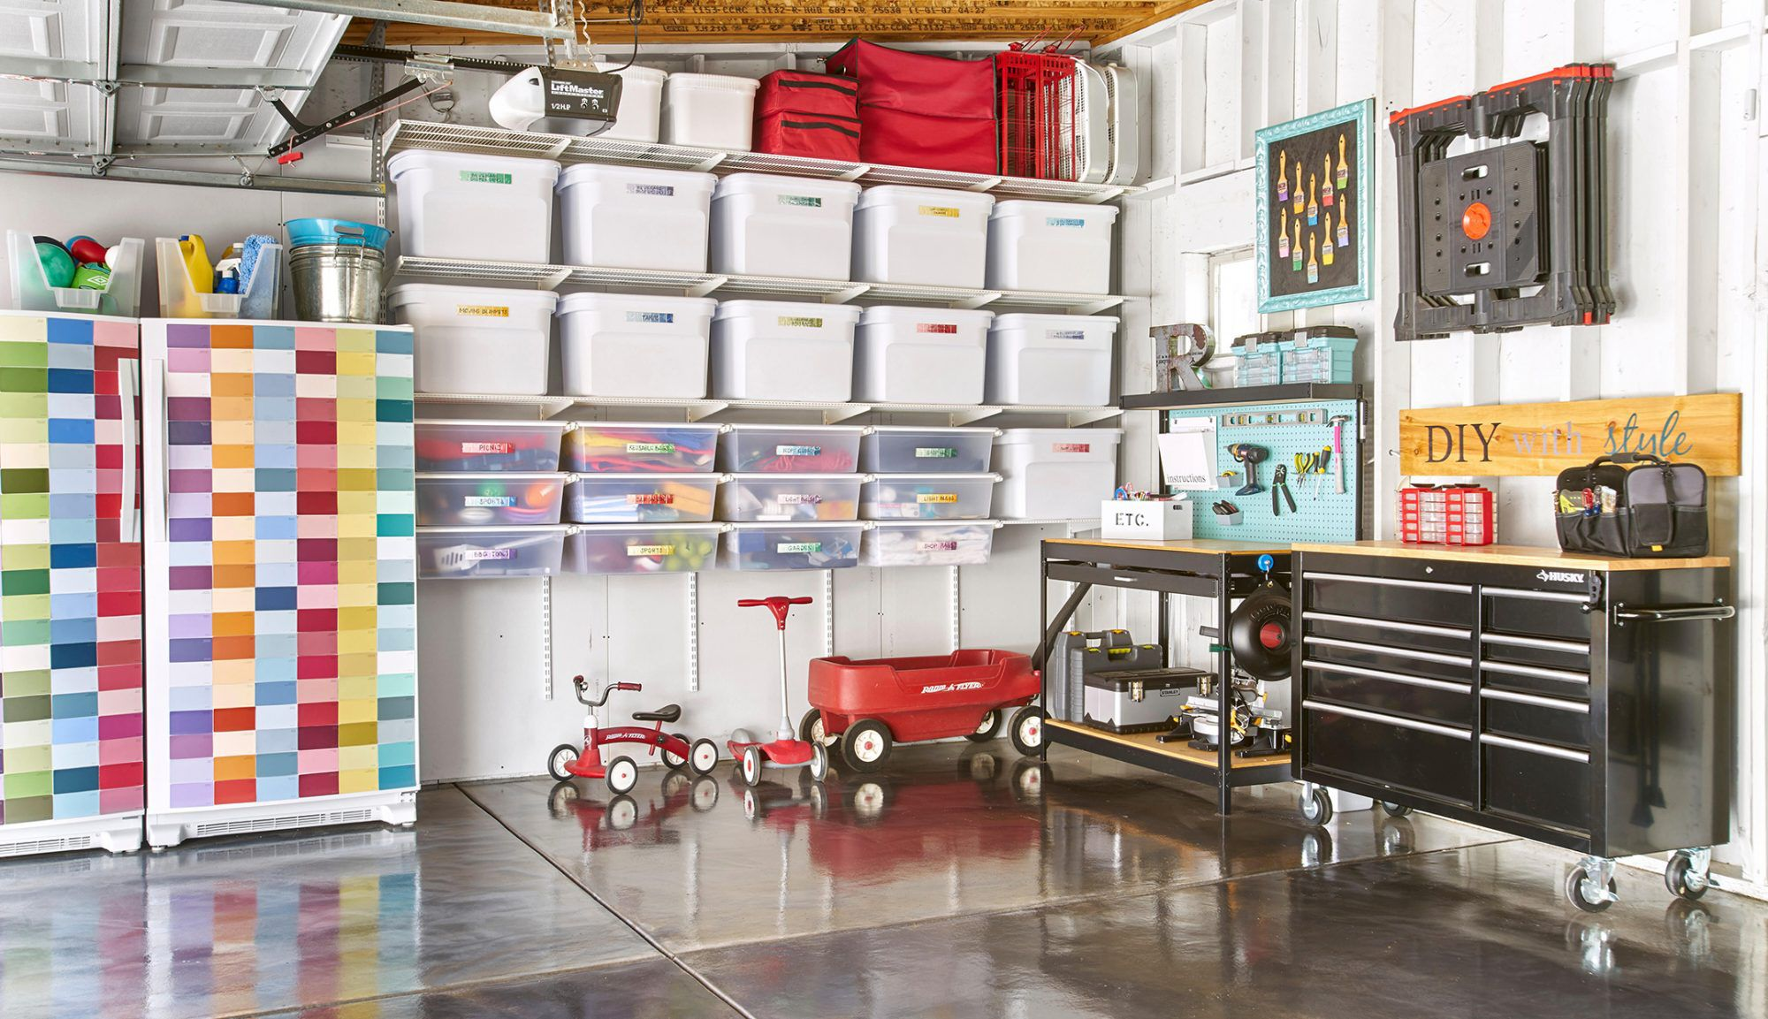

Slide 9

An Organized Garage
B1
B2
Item | Box
Tools | B1
DVDs | B2
Books | B3
Snacks | B4
B3
B4

Slide 10
Disorganized
Organized
B1
B2
Item | Box
Tools | B1
DVDs | B2
Books | B3
Snacks | B4
B3
B4
Space efficient
Slow to lookup item
std::vector<T>
Space inefficient
Quick to lookup item
std::map<std::string, T>

Slide 11
Lecture 5: Containers
Stanford CS106L, Autumn 2024

Slide 12

Today we’re going beyond the Stanford C++ libraries!
std::map
Map
Vector
std::vector
Set
std::set
(But we’ll still make references to them)

Slide 13
The many containers of C++
The C++ Standard Template Library (STL)
std::vector
std::unordered_map
std::set
std::unordered_set
std::stack
std::priority_queue
std::queue
std::deque
std::map
std::array

Slide 14
Which container do I use?

Slide 15

The space-time tradeoff

Slide 16

“Space is time” — Bjarne Stroustrup
[source]

Slide 17
Today’s Agenda
What the heck is the STL? What are templates?
”The Standard Template Library”
Sequence Containers
A linear sequence of elements
Associative Containers
A set of elements organized by unique keys

Slide 18
Disclaimer: We’re covering a lot of material!
(try not to get lost in the details!)

Slide 19
But also: we can’t cover everything!
(please ask us questions or reach out on Ed!)

Slide 21
What is the STL?

Slide 22
STL: Standard Template Library

Slide 23

What are templates?
I need a way to store lists of integers!
🧑‍💻️
I am on it!

Slide 24
What are templates?
class IntVector {
// Code to store
// a list of
// integers…
};
I’ve done it!
🧑‍💻️

Slide 25
What are templates?
Now I need to store a list of doubles!
🧑‍💻️
Right on it!

Slide 26
What are templates?
class DoubleVector {
// Code to store
// a list of
// doubles…
};
I’ve done it!
🧑‍💻️

Slide 27

What are templates?
So could you give me a list of STRINGS…
🧑‍💻️
🤯😠😠

Slide 28
What if we could keep the logic, but change the type?

Slide 29
What are templates?
class IntVector {
// Code to store
// a list of
// integers…
};
template <typename T>
class vector {
// So satisfying.
};
vector<int> v1;
vector<double> v2;
vector<string> v3;
class DoubleVector {
// Code to store
// a list of
// doubles…
};
class StringVector {
// Code to store
// a list of
// strings…
};

Slide 30
All STL containers are templates!

Slide 31
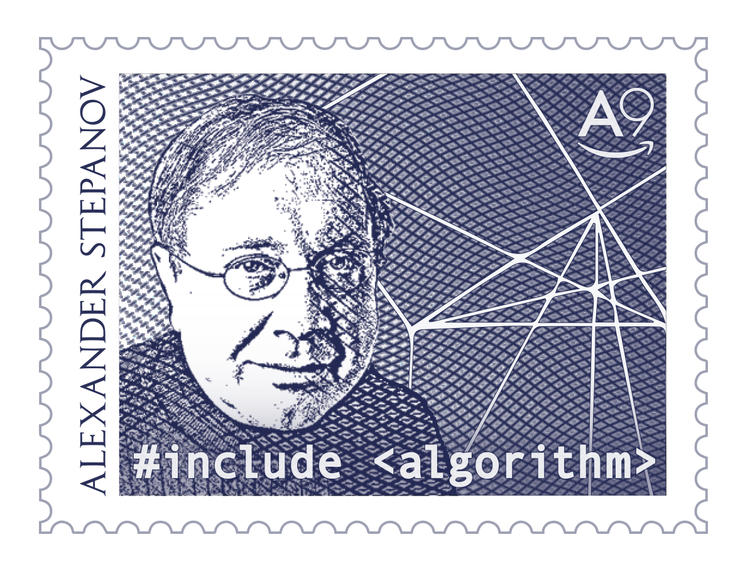

The Standard Template Library (STL)
Created by Alexander Stepanov
Added templates to C++ and built a well-known library
This library is now known as the STL!
Bjarne, let’s add templates
Huh?
Hold my beer

Slide 32
The Standard Template Library (STL)
std
stl
pair<T1,T2>
vector<T>
map<K,V>

Slide 33
The Standard Template Library (STL)
Containers
How do we store groups of things?
Iterators
How do we traverse containers?
Functors
How can we represent functions as objects?
Algorithms
How do we transform and modify containers in a generic way?

Slide 35
Sequence Containers

Slide 36
Sequence containers store a linear sequence of elements

Slide 37
std::vector #include <vector>

Slide 38
std::vector stores a list of elements
std::vector<int> vec { 1, 2, 3, 4 };
vec.push_back(5);
vec.push_back(6);
vec[1] = 20;
for (size_t i = 0; i < vec.size(); i++) {
std::cout << vec[i] << " ";
}
0
1
2
3
4
5
Output:
1 20 3 4 5 6
1
2
20
3
4
5
6
vec

Slide 39
Stanford vs. STL vector
What you want to do? | Stanford Vector<int> | std::vector<int>
Create an empty vector | Vector<int> v; | std::vector<int> v;
Create a vector with n copies of 0 | Vector<int> v(n); | std::vector<int> v(n);
Create a vector with n copies of value k | Vector<int> v(n, k); | std::vector<int> v(n, k);

Slide 40
Stanford vs. STL vector
What you want to do? | Stanford Vector<int> | std::vector<int>
Create an empty vector | Vector<int> v; | std::vector<int> v;
Create a vector with n copies of 0 | Vector<int> v(n); | std::vector<int> v(n);
Create a vector with n copies of value k | Vector<int> v(n, k); | std::vector<int> v(n, k);
Add k to the end of the vector | v.add(k); | v.push_back(k);
Clear vector | v.clear(); | v.clear();
Check if v is empty | if (v.isEmpty()) | if (v.empty())

Slide 41
Stanford vs. STL vector
What you want to do? | Stanford Vector<int> | std::vector<int>
Create an empty vector | Vector<int> v; | std::vector<int> v;
Create a vector with n copies of 0 | Vector<int> v(n); | std::vector<int> v(n);
Create a vector with n copies of value k | Vector<int> v(n, k); | std::vector<int> v(n, k);
Add k to the end of the vector | v.add(k); | v.push_back(k);
Clear vector | v.clear(); | v.clear();
Check if v is empty | if (v.isEmpty()) | if (v.empty())
Get the element at index i | int v = v.get(i); int k = v[i]; | int k = v.at(i); int k = v[i];
Replace the element at index i | v.get(i) = k; v[i] = k; | v.at(i) = k; v[i] = k;

Slide 42
How is vector implemented?
5
0
1
2
3
1
2
3
4
1
2
3
4
0
1
2
3
4
5
6
7
size = 2, capacity = 4
size = 3, capacity = 4
size = 4, capacity = 4
size = 5, capacity = 8

Slide 44
Tip: Use range-based for when possible
for (size_t i = 0; i < vec.size(); i++) {
std::cout << vec[i] << " ";
}
for (auto elem : vec) {
std::cout << elem << " ";
}
Applies for all iterable containers, not just std::vector

Slide 45
Tip: Use const auto& when possible
std::vector<MassiveType> vec { ... };
for (auto elem : vec) ...
for (const auto& elem : v)
Applies for all iterable containers, not just std::vector
Saves making a potentially expensive copy of each element

Slide 46
Stanford vs. STL vector
What you want to do? | Stanford Vector<int> | std::vector<int>
Create an empty vector | Vector<int> v; | std::vector<int> v;
Create a vector with n copies of 0 | Vector<int> v(n); | std::vector<int> v(n);
Create a vector with n copies of value k | Vector<int> v(n, k); | std::vector<int> v(n, k);
Add k to the end of the vector | v.add(k); | v.push_back(k);
Clear vector | v.clear(); | v.clear();
Check if v is empty | if (v.isEmpty()) | if (v.empty())
Get the element at index i | int v = v.get(i); int k = v[i]; | int k = v.at(i); int k = v[i];
Replace the element at index i | v.get(i) = k; v[i] = k; | v.at(i) = k; v[i] = k;

Slide 47
operator[] does not perform bounds checking
std::vector<int> vec{5, 6}; // {5, 6}
vec[1] = 3; // {5, 3}
vec[2] = 4; // undefined behavior
vec.at(2) = 4; // Runtime error

Slide 48
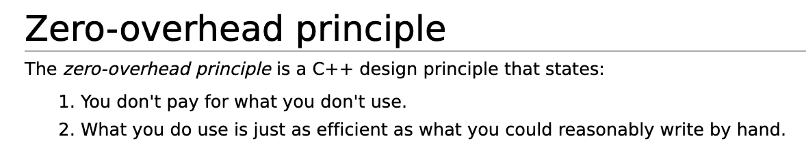
[cppreference]

Slide 50
std::vector is not the best for all cases…
Suppose we need to observe the last 10,000 prices of a stock
What might be concerning about the code below?
void receivePrice(vector<double>& prices, double price)
{
prices.push_front(price);
if (prices.size() > 10000)
prices.pop_back(); // Remove last price
// so we don't exceed 10k
}

Slide 51

Trick question! std::vector has no push_front!

Slide 52
A hypothetical push_front…
0
1
2
3
4
…
9998
9999
6
2
7
1
8
…
2
4
0
1
2
3
4
…
9998
9999
6
2
7
1
…
5
2
SLOW!!!

Slide 53
std::deque #include <deque>

Slide 54
std::deque
A deque (“deck”) is a double-ended queue
Allows efficient insertion/removal at either end
void receivePrice(deque<double>& prices, double price)
{
prices.push_front(price); // Super fast
if (prices.size() > 10000)
prices.pop_back(); // Remove last price
// so we don't exceed 10k
}

Slide 55
A deque has the same interface as vector, except we can push_front / pop_front

Slide 56
How is deque implemented?
1
9
7
3
2
1
2
9
The problem with vector is that we have a single chunk of memory
So... let’s split it up!

Slide 57
How is deque implemented?
Array of arrays
1
9
3
2
1
9
7
3
2
1
2
9
Separate subarrays allocated independently

Slide 59
Announcements
Assignment 1 due Friday!
Submission instructions will posted tonight
OH times announced
Fabio 3-4pm Wednesdays on Zoom
Jacob 1-2:30pm Fridays in Thornton 208

Slide 60
Associative Containers

Slide 61
Associative containers organize elements by unique keys

Slide 62
std::map #include <map>

Slide 63
std::map maps keys to values
std::map<std::string, int>
”CS106L!”
42
Equivalent of a Python dictionary
Sometimes called an associative array

Slide 64
std::map maps keys to values
std::map<std::string, int> map {
{ "Chris", 2 },
{ "CS106L", 42 },
{ "Keith", 14 },
{ "Nick", 51 },
{ "Sean", 35 },
};
int sean = map["Sean"]; // 35
map["Chris"] = 31;
“Chris”
2
31
“CS106L”
42
“Keith”
14
“Nick”
51
“Sean”
35

Slide 65
Stanford vs. STL map
What you want to do? | Stanford Map<char, int> | std::map<char, int>
Create an empty map | Map<char, int> m; | std::map<char, int> m;

Slide 66
Stanford vs. STL map
What you want to do? | Stanford Map<char, int> | std::map<char, int>
Create an empty map | Map<char, int> m; | std::map<char, int> m;
Add key k with value v into the map | m.put(k, v); m[k] = v; | m.insert({k, v}); m[k] = v;
Remove key k from the map | m.remove(k); | m.erase(k);

Slide 67
Stanford vs. STL map
What you want to do? | Stanford Map<char, int> | std::map<char, int>
Create an empty map | Map<char, int> m; | std::map<char, int> m;
Add key k with value v into the map | m.put(k, v); m[k] = v; | m.insert({k, v}); m[k] = v;
Remove key k from the map | m.remove(k); | m.erase(k);
Check if k is in the map (* C++20) | if (m.containsKey(k)) | if (m.count(k)) if (m.contains(k)) (*)
Check if the map is empty | if (m.isEmpty()) | if (m.empty())

Slide 68
Stanford vs. STL map
What you want to do? | Stanford Map<char, int> | std::map<char, int>
Create an empty map | Map<char, int> m; | std::map<char, int> m;
Add key k with value v into the map | m.put(k, v); m[k] = v; | m.insert({k, v}); m[k] = v;
Remove key k from the map | m.remove(k); | m.erase(k);
Check if k is in the map (* C++20) | if (m.containsKey(k)) | if (m.count(k)) if (m.contains(k)) (*)
Check if the map is empty | if (m.isEmpty()) | if (m.empty())
Retrieve or overwrite value associated with key k (auto-insert default if doesn’t exist) | int i = m[k]; m[k] = i; | int i = m[k]; m[k] = i;

Slide 69
std::map<K, V> stores a collection of std::pair<const K, V>
(I encourage you to think about why K is const.
What would happen if we could modify a key?)

Slide 70
map as a collection of pair
We can iterate through the key-value pairs using a range based for loop
std::map<std::string, int> map;
for (auto kv : map) {
// kv is a std::pair<const std::string, int>
std::string key = kv.first;
int value = kv.second;
}

Slide 71
map as a collection of pair
Structured bindings come in handy when iterating a map
std::map<std::string, int> map;
for (const auto& [key, value] : map) {
// key has type const std::string&
// value has type const int&
}

Slide 73
How is map implemented?
“Chris”
“CS106L”
42
“Chris”
31
31
“Chris”
31
“Nick”
51
“CS106L”
“CS106L”
42
42
“Keith”
14
“Sean”
35
“Keith”
“Keith”
14
14
“Nick”
“Nick”
51
51
Binary Search Tree
(technically a red-black tree)
“Sean”
“Sean”
35
35

Slide 74
What is map[“Keith”]?
”Keith” < “CS106L” ?
“CS106L”
42
No! Go right
“Chris”
31
“Nick”
51
”Keith” < “Nick” ?
Yes! Go left
”Keith” < “Keith” ?
“Keith”
14
“Sean”
35
Hey look, you found me!
map[“Keith”] = 14

Slide 75
What is map[“Alex”]?
”Alex” < “CS106L” ?
“CS106L”
42
Yes! Go left
”Alex” < “Chris” ?
“Chris”
31
“Nick”
51
Yes! Go left... wait
“Alex”
0
“Keith”
14
“Sean”
35
map[“Alex”] = 0
(Note: ”Alex” was default-inserted into the map)

Slide 76
std::map<K, V> requires K to have an operator<

Slide 77
std::map<K, V> requires K to have an operator<
// ✅ OKAY - int has operator<
std::map<int, int> map1;
// ❌ ERROR - std::ifstream has no operator<
std::map<std::ifstream, int> map2;

Slide 79
std::set #include <set>

Slide 80


std::set stores a collection of unique items
$$\{ \}$$
std::set<std::string> set {
"CS106L!",
"Keith",
"Sean",
"Nick",
"Chris"
};
$$≈$$
“CS106L!”
“Keith”
“Sean”
“Nick”
“Chris”

Slide 81
Stanford vs. STL set
What you want to do? | Stanford Set<char> | std::set<char>
Create an empty set | Set<char> s; | std::set<char> s;
Add k to the set | s.add(k); | s.insert(k);
Remove k from the set | s.remove(k); | s.erase(k);
Check if k is in the set (* C++20) | if (s.contains(k)) | if (s.count(k)) if (s.contains(k)) (*)
Check if the set is empty | if (s.isEmpty()) | if (s.empty())

Slide 82
std::set is an amoral std::map
std::set is an std::map without values

Slide 83
How is set implemented?
“Chris”
“CS106L”
“Chris”
“Nick”
“CS106L”
“Keith”
“Sean”
“Keith”
“Nick”
Binary Search Tree
(technically a red-black tree)
“Sean”

Slide 84
But wait... map and set have an alter ego 🥷🥷

Slide 85
std::unordered_map and std::unordered_set #include <unordered_map> #include <unordered_set>

Slide 86
std::unordered_map
You can think of unordered_map as an optimized version of map
It has the same interface as map
std::unordered_map<std::string, int> map {
{ "Chris", 2 },
{ "Nick", 51 },
{ "Sean", 35 },
};
int sean = map["Sean"]; // 35
map["Chris"] = 31;

Slide 87

How is unordered_map implemented?
Remember, map is a collection of std::pair
unordered_map stores a collection of $n$ ”buckets” of pairs
std::unordered_map
<std::string, int> map {
{ "Chris", 31 },
{ "Nick", 51 },
{ "Sean", 35 },
};
0
“Chris”
31
1
2
“Nick”
51
3
“Sean”
35
4

Slide 88
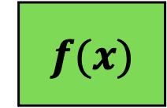
How is unordered_map implemented?
To add a key/value, we feed the key through a hash function
The hash, modulo the bucket count, determines the pair’s bucket no.
int x = map["CS106L"];
0
“Chris”
31
1
$$f(x)$$
“CS106L”
80489869
2
“Nick”
51
3
“Sean”
35
80489869 mod 5 = 4
4
“CS106L”
0

Slide 89
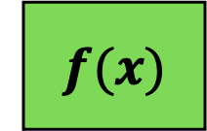
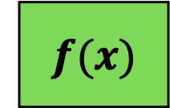
What is a hash function?
“Scrambles” a key into a size_t (64 bit)
Small changes in the input should produce large changes in the output
“CS106L”
$$f(x)$$
80489869
“CS106L”
80489869
$$f(x)$$
“CS106B”
31580239

Slide 90
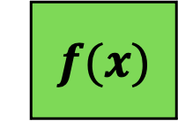
How is unordered_map implemented?
If two keys hash to the same bucket, we get a hash collision
During lookup, we loop through bucket and check key equality
Two keys with the same hash are not necessarily equal!
“Chris”
31
map[”Keith"] = 64;
0
1
1302912 mod 5 = 2
5012347 mod 5 = 2
$$f(x)$$
“Keith”
5012347
“Nick”
51
“Keith”
14
2
64
3
“Sean”
35
5012347 mod 5 = 2
4

Slide 91
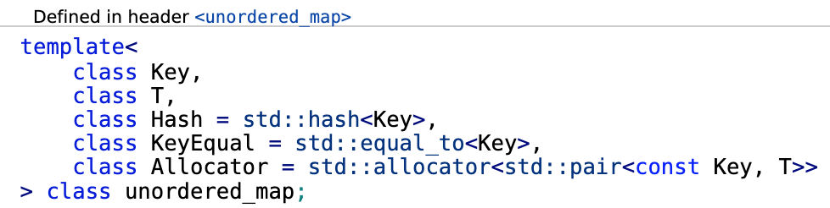
std::unordered_map<K, V> requires K to have a hash function (and equality)
(We will learn more about this syntax later!)

Slide 92
std::unordered_map<K, V> requires K to be hashable
// ✅ OKAY - int is hashable
std::unordered_map<int, int> map1;
// ❌ ERROR - std::ifstream is not hashable
std::unordered_map<std::ifstream, int> map2;
Most basic types (int, double, string) are hashable by default

Slide 94
Why use std::unordered_map?
Load factor: average number items per bucket
unordered_map allows super fast lookup by keeping load factor small
If load factor gets too large (above 1.0 by default), we rehash
0
“Chris”
31
Load Factor: 1.66
1
“Sean”
35
“CS106L”
0
2
“Nick”
64
“Keith”
14
Load Factor: 1.0
3
4

Slide 95
Fun C++ Trivia: max_load_factor
You can control the max load factor before rehashing
std::unordered_map<std::string, int> map;
double lf = map.load_factor(); // Get current load factor
map.max_load_factor(2.0); // Set the max load factor
// Now the map will not rehash until load factor exceeds 2.0
// You should almost never need to do this,
// but it’s a fun fact (good for parties!)

Slide 96
What makes a good hash function?
A good hash function minimizes the chance of a hash collision
// ❌ The worst possible hash
template <>
struct std::hash<MyType>
{
std::size_t operator()(const MyType& k) const
{
return 0;
}
};
(Don’t worry too much about this syntax. We’ll learn more later)

Slide 97
unordered_set is an unordered_map without values
std::unordered_set
<std::string> set {
"Chris",
"Nick",
"Sean",
”CS106L"
};
“Chris”
0
1
2
“Nick”
3
“Sean”
4
“CS106L”

Slide 98
When to use unordered_map vs. map?
unordered_map is usually faster than map
However, it uses more memory (organized vs. disorganized garage)
If your key type has no total order (operator<), use unordered_map!
If you must choose, unordered_map is a safe bet

Slide 100
Recap

Slide 101
Summary of Data Structures
 | i^{th} element | Search | Insertion | Erase
std::vector | Very Fast | Slow | Slow | Slow
std::deque | Fast | Slow | Fast (front/back) Slow (all others) | Fast (front/back) Slow (all others)
std::set | Slow | Fast | Fast | Fast
std::map | Slow | Fast | Fast | Fast
std::unordered_set | N/A | Very Fast | Very Fast | Very Fast
std::unordered_map | N/A | Very Fast | Very Fast | Very Fast
Space per Element

Slide 102
Some more containers if you’re curious!
std::array
A fixed-size array of items
std::list
A doubly linked list
std::multiset (+unordered)
A set that can contain duplicates
std::multimap (+unordered)
Can contain multiple values for the same key

Slide 103
Recap
What the heck is the STL? What are templates?
”The Standard Template Library”
Sequence Containers
A linear sequence of elements
std::vector, std::deque
Associative Containers
A set of elements organized by unique keys
std::map, std::set, std::unordered_map, std::unordered_set

